Slide 1
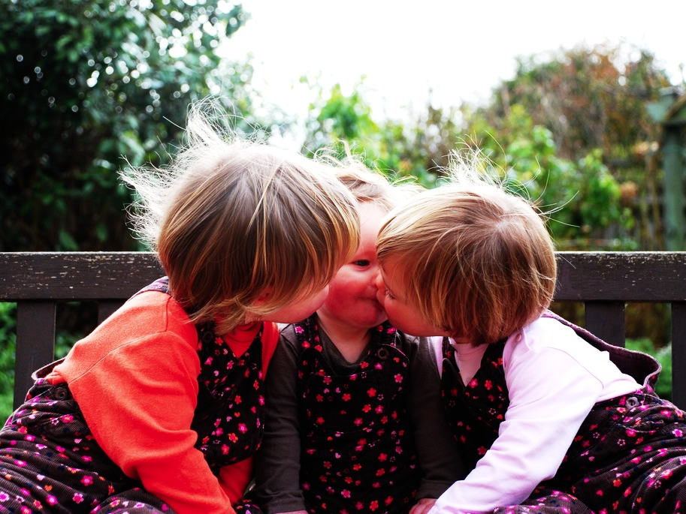
Mindreading & Joint Action
7. What Is Joint Action
Shared Agency?
butterfillS@ceu.hu
butterfillS@ceu.hu

Slide 2
Outline
1. The leading philosophical approach to shared agency
2. Limits of this approach
3. (Building blocks for) an alternative approach
4. Motor representation
5. The emergence of mindreading

Slide 3
1. The leading philosophical approach to shared agency

Slide 4
Merely Parallel Individual Agency
Shared Agency
Members of a flash mob simultaneously open their newspapers noisily
Onlookers simultaneously open their newspapers noisily
(cf. Searle 1990: 92)
Two friends walk to the metro station together.
Two strangers walk the same route side-by-side.
(Gilbert 1990)

Slide 5
‘I take a collective action to involve a collective [shared] intention.’
(Gilbert 2006, p. 5)
Notes:
so MG says ...

Slide 6
‘I take a collective action to involve a collective [shared] intention.’
(Gilbert 2006, p. 5)
‘The sine qua non of collaborative action is a joint goal [shared intention] and a joint commitment’
(Tomasello 2008, p. 181)

Slide 7
‘I take a collective action to involve a collective [shared] intention.’
(Gilbert 2006, p. 5)
‘The sine qua non of collaborative action is a joint goal [shared intention] and a joint commitment’
(Tomasello 2008, p. 181)
‘the key property of joint action lies in its internal component [...] in the participants’ having a “collective” or “shared” intention.’
(Alonso 2009, pp. 444-5)

Slide 8
‘I take a collective action to involve a collective [shared] intention.’
(Gilbert 2006, p. 5)
‘The sine qua non of collaborative action is a joint goal [shared intention] and a joint commitment’
(Tomasello 2008, p. 181)
‘the key property of joint action lies in its internal component [...] in the participants’ having a “collective” or “shared” intention.’
(Alonso 2009, pp. 444-5)
‘Shared intentionality is the foundation upon which joint action is built.’
(Carpenter 2009, p. 381)

Slide 9
shared
intention
(or ’collective’)

Slide 10
shared intention
<---->
action
w. shared agency
intention
<---->
action
w. individual agency
Notes:
Despite the disagreement on details, I think one thing almost everyone agrees about is this: shared intention is to joint action at least approximately what ordinary individual intention is to ordinary, individual action.
This doesn’t massively help us. The question was, What is joint action? The answer was, something that stands in an appropriate relation to a shared intention. Then we ask what a shared intention is. And the answer is, it’s something that stands in an appropriate relation to a joint action. I don’t think all circles are bad, but this circle doesn’t provide much insight into what joint action is.
SO WE NEED AN ACCOUNT OF SHARED INTENTION

Slide 11
What is the relation between a purposive joint action and the outcome or outcomes to which it is directed?

Slide 12
What is the relation between a purposive joint action and the outcome or outcomes to which it is directed?
out
out
act
out
out

Slide 13
What is the relation between a purposive joint action and the outcome or outcomes to which it is directed?
out
out
act
represents
coordinates
out
shared intention
out

Slide 14
What is the relation between a purposive joint action and the outcome or outcomes to which it is directed?
out
out
act
represents
coordinates
out
shared intention
out
Notes:
I stipulate that the term joint action refers to an exercise of shared agency.

Slide 15
What is the relation between a purposive joint action and the outcome or outcomes to which it is directed?
out
out
act
out
act
out

Slide 16
What is the relation between a purposive joint action and the outcome or outcomes to which it is directed?
out
out
act
represents
coordinates
out
act
shared intention
out

Slide 17
What is the relation between a purposive joint action and the outcome or outcomes to which it is directed?
out
out
act
represents
coordinates
out
act
shared intention
out
Notes:
Integration of shared intention and ordinary individual intention in practical reasoning; mutually constraining ...

Slide 18
shared intention
<---->
action
w. shared agency
intention
<---->
action
w. individual agency
Notes:
It’s important to see that we’ve been moving in a circle.
We’ve been exploring a parallel between individual and shared intention.
But ...

Slide 19
shared intention
<---->
action
w. shared agency
intention
<---->
action
w. individual agency
Notes:
This doesn’t massively help us. The question was, What is joint action? The answer was, something that stands in an appropriate relation to a shared intention. Then we ask what a shared intention is. And the answer is, it’s something that stands in an appropriate relation to a joint action. I don’t think all circles are bad, but this circle doesn’t provide much insight into what joint action is.
SO WE NEED AN ACCOUNT OF SHARED INTENTION

Slide 20
shared intention
<---->
action
w. shared agency
intention
<---->
action
w. individual agency
Notes:
Despite the disagreement on details, I think one thing almost everyone agrees about is this: shared intention is to joint action at least approximately what ordinary individual intention is to ordinary, individual action.
This doesn’t massively help us. The question was, What is joint action? The answer was, something that stands in an appropriate relation to a shared intention. Then we ask what a shared intention is. And the answer is, it’s something that stands in an appropriate relation to a joint action. I don’t think all circles are bad, but this circle doesn’t provide much insight into what joint action is.
SO WE NEED AN ACCOUNT OF SHARED INTENTION

Slide 21
What is shared intention?
shared intention
<---->
action
w. shared agency
intention
<---->
action
w. individual agency

Slide 22
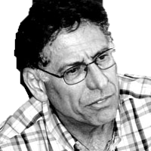
What is shared intention?
What is shared intention?
shared intention
<---->
action
w. shared agency
intention
<---->
action
w. individual agency

Slide 23
What is shared intention?
Functional characterisation
Substantial account

Slide 24
What is shared intention?
Functional characterisation
shared intention serves to (a) coordinate activities, (b) coordinate planning and (c) structure bargaining
Substantial account

Slide 25
What is shared intention?
Functional characterisation
shared intention serves to (a) coordinate activities, (b) coordinate planning and (c) structure bargaining
Substantial account
We have a shared intention that we J if
“1. (a) I intend that we J and (b) you intend that we J

Slide 26
What is shared intention?
Functional characterisation
shared intention serves to (a) coordinate activities, (b) coordinate planning and (c) structure bargaining
Substantial account
We have a shared intention that we J if
“1. (a) I intend that we J and (b) you intend that we J
“2. I intend that we J in accordance with and because of la, lb, and meshing subplans of la and lb; you intend [likewise] …

Slide 27
What is shared intention?
Functional characterisation
shared intention serves to (a) coordinate activities, (b) coordinate planning and (c) structure bargaining
Substantial account
We have a shared intention that we J if
“1. (a) I intend that we J and (b) you intend that we J
“2. I intend that we J in accordance with and because of la, lb, and meshing subplans of la and lb; you intend [likewise] …
“3. 1 and 2 are common knowledge between us”
(Bratman 1993: View 4)

Slide 28
Outline
1. The leading philosophical approach to shared agency
2. Limits of this approach
3. (Building blocks for) an alternative approach
4. Motor representation
5. The emergence of mindreading

Slide 29
Outline
1. The leading philosophical approach to shared agency
2. Limits of this approach
3. (Building blocks for) an alternative approach
4. Motor representation
5. The emergence of mindreading

Slide 30
What is shared intention?
Functional characterisation
shared intention serves to (a) coordinate activities, (b) coordinate planning and (c) structure bargaining
Substantial account
We have a shared intention that we J if
“1. (a) I intend that we J and (b) you intend that we J
“2. I intend that we J in accordance with and because of la, lb, and meshing subplans of la and lb; you intend [likewise] …
“3. 1 and 2 are common knowledge between us”
(Bratman 1993: View 4)

Slide 31


What is shared intention?
Functional characterisation
shared intention serves to (a) coordinate activities, (b) coordinate planning and (c) structure bargaining
Substantial account
We have a shared intention that we J if
“1. (a) I intend that we J and (b) you intend that we J
“2. I intend that we J in accordance with and because of la, lb, and meshing subplans of la and lb; you intend [likewise] …
“3. 1 and 2 are common knowledge between us”
(Bratman 1993: View 4)
“the contribution of lower-level processes to social interaction has hardly been considered. This has led philosophers to postulate complex intentional structures that often seem to be beyond human cognitive ability in real-time social interactions.”
(Knoblich & Sebanz 2008: 2022)

Slide 32
What is shared intention?
Functional characterisation
shared intention serves to (a) coordinate activities, (b) coordinate planning and (c) structure bargaining
Substantial account
We have a shared intention that we J if
“1. (a) I intend that we J and (b) you intend that we J
“2. I intend that we J in accordance with and because of la, lb, and meshing subplans of la and lb; you intend [likewise] …
“3. 1 and 2 are common knowledge between us”
(Bratman 1993: View 4)
{
Intentions about intentions

Slide 33
What is shared intention?
Functional characterisation
shared intention serves to (a) coordinate activities, (b) coordinate planning and (c) structure bargaining
Substantial account
We have a shared intention that we J if
“1. (a) I intend that we J and (b) you intend that we J
“2. I intend that we J in accordance with and because of la, lb, and meshing subplans of la and lb; you intend [likewise] …
“3. 1 and 2 are common knowledge between us”
(Bratman 1993: View 4)
{
Intentions about intentions
{
Knowledge of others' knowledge of intentions about intentions

Slide 34
What is shared intention?
Functional characterisation
shared intention serves to (a) coordinate activities, (b) coordinate planning and (c) structure bargaining
Substantial account
We have a shared intention that we J if
“1. (a) I intend that we J and (b) you intend that we J
“2. I intend that we J in accordance with and because of la, lb, and meshing subplans of la and lb; you intend [likewise] …
“3. 1 and 2 are common knowledge between us”
(Bratman 1993: View 4)
{
Intentions about intentions
{
Knowledge of others' knowledge of intentions about intentions

Slide 35
What is shared intention?
Functional characterisation
shared intention serves to (a) coordinate activities, (b) coordinate planning and (c) structure bargaining
Substantial account
We have a shared intention that we J if
“1. (a) I intend that we J and (b) you intend that we J
“2. I intend that we J in accordance with and because of la, lb, and meshing subplans of la and lb; you intend [likewise] …
“3. 1 and 2 are common knowledge between us”
(Bratman 1993: View 4)

Slide 36
What is shared intention?
Functional characterisation
shared intention serves to (a) coordinate activities, (b) coordinate planning and (c) structure bargaining
Substantial account
We have a shared intention that we J if
“1. (a) I intend that we J and (b) you intend that we J
“2. I intend that we J in accordance with and because of la, lb, and meshing subplans of la and lb; you intend [likewise] …
“3. 1 and 2 are common knowledge between us”
(Bratman 1993: View 4)
'shared intentional agency consists, at bottom, in interconnected planning agency of the participants.'
(Bratman 2011, p. 11)

Slide 37
What is shared intention?
Functional characterisation
shared intention serves to (a) coordinate activities, (b) coordinate planning and (c) structure bargaining
Substantial account
We have a shared intention that we J if
“1. (a) I intend that we J and (b) you intend that we J
“2. I intend that we J in accordance with and because of la, lb, and meshing subplans of la and lb; you intend [likewise] …
“3. 1 and 2 are common knowledge between us”
(Bratman 1993: View 4)
“the contribution of lower-level processes to social interaction has hardly been considered. This has led philosophers to postulate complex intentional structures that often seem to be beyond human cognitive ability in real-time social interactions.”
(Knoblich & Sebanz 2008: 2022)
Notes:
So Natalie and Guenther are right.
But so what if, on Bratman’s account, shared intention requires conceptual and cognitive sophistication.
Maybe this is just how it is with joint action?
So I don’t think there’s an objection to the account here yet.
There’s just a question.
The question is whether there are forms of shared agency which are not demanding in the way that Bratman’s account suggests.

Slide 38
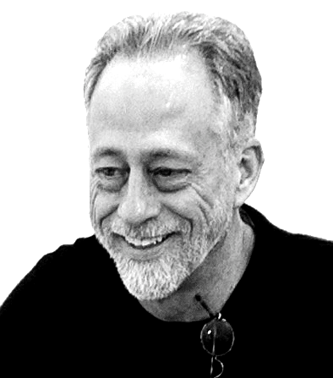

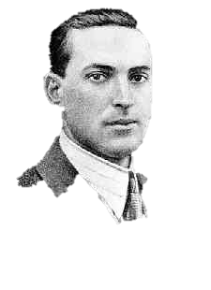
“participation in cooperative, cultural interactions ... leads children to construct uniquely powerful forms of cognitive representation.”
(Moll & Tomasello 2007)

Slide 39
“participation in cooperative, cultural interactions ... leads children to construct uniquely powerful forms of cognitive representation.”
(Moll & Tomasello 2007)
“perception, action, and cognition are grounded in social interaction”
(Sebanz & Knoblich 2008)

Slide 40


“participation in cooperative, cultural interactions ... leads children to construct uniquely powerful forms of cognitive representation.”
(Moll & Tomasello 2007)
“perception, action, and cognition are grounded in social interaction”
(Sebanz & Knoblich 2008)
“human cognitive abilities ... [are] built upon social interaction”
(Sinigaglia and Sparaci 2008)

Slide 41
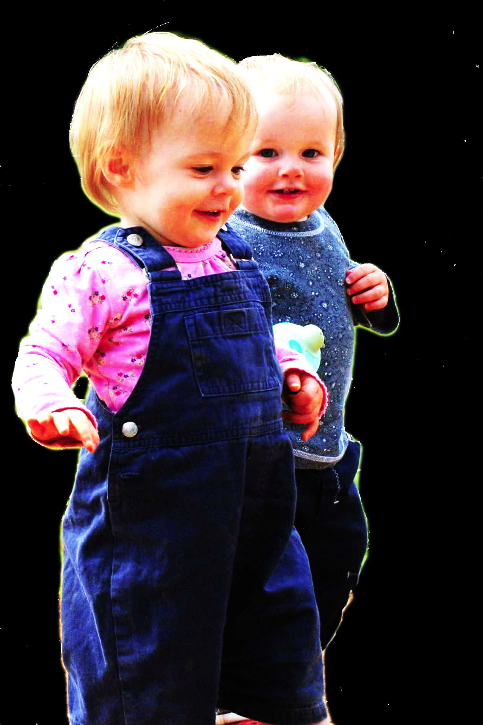
conjecture
The prior existence of capacities for shared agency partially explains how sophisticated forms of mindreading emerge in evolution or development (or both)

Slide 42
1. All shared agency involves shared intention.
2. Shared intention requires sophisticated mindreading.
Therefore:
conjecture
3.
The prior existence of capacities for shared agency partially explains how sophisticated forms of mindreading emerge in evolution or development (or both)
cannot explain

Slide 43
1. All shared agency involves shared intention.
2. Shared intention requires sophisticated mindreading.
Therefore:
conjecture
3.
The prior existence of capacities for shared agency partially explains how sophisticated forms of mindreading emerge in evolution or development (or both)
cannot explain

Slide 44
1. All shared agency involves shared intention.
2. Shared intention requires sophisticated mindreading.
Therefore:
conjecture
3.
The prior existence of capacities for shared agency partially explains how sophisticated forms of mindreading emerge in evolution or development (or both)
cannot explain

Slide 45
1. All shared agency involves shared intention.
2. Shared intention requires sophisticated mindreading.
Therefore:
3. Shared agency could play no significant role in explaining how sophisticated forms of mindreading emerge.
shared intention
<---->
action
w. shared agency
intention
<---->
action
w. individual agency
Notes:
I think we shouldn’t assume that all shared agency involves shared intention.
After all, the parallel with ordinary, individual agency suggests otherwise.

Slide 46
1. All shared agency involves shared intention.
2. Shared intention requires sophisticated mindreading.
Therefore:
conjecture
3.
The prior existence of capacities for shared agency partially explains how sophisticated forms of mindreading emerge in evolution or development (or both)
cannot explain
Notes:
So this is the argument ...

Slide 47
Outline
1. The leading philosophical approach to shared agency
2. Limits of this approach
3. (Building blocks for) an alternative approach
4. Motor representation
5. The emergence of mindreading

Slide 48
Outline
1. The leading philosophical approach to shared agency
2. Limits of this approach
3. (Building blocks for) an alternative approach
4. Motor representation
5. The emergence of mindreading

Slide 49
shared agency without shared intention
Notes:
So this is the argument ...

Slide 50
Joint action:
an action with two or more agents (Ludwig 2007)

Slide 51
Joint action:
an action with two or more agents (Ludwig 2007)

Slide 52
Joint action:
an action with two or more agents (Ludwig 2007)
‘our primitive actions, the ones we do not by doing something else, ... these are all the actions there are.’ (Davidson 1971, p. 59).

Slide 53
Joint action:
an action with two or more agents (Ludwig 2007)
‘our primitive actions, the ones we do not by doing something else, ... these are all the actions there are.’ (Davidson 1971, p. 59).
move fingers
unlock door
turn key

Slide 54
Joint action:
an action with two or more agents (Ludwig 2007)
‘our primitive actions, the ones we do not by doing something else, ... these are all the actions there are.’ (Davidson 1971, p. 59).
move fingers
unlock door
turn key

Slide 55
Joint action:
an action with two or more agents (Ludwig 2007)
‘our primitive actions, the ones we do not by doing something else, ... these are all the actions there are.’ (Davidson 1971, p. 59).
move fingers
unlock door
turn key

Slide 56
Joint action:
an action with two or more agents (Ludwig 2007)
‘our primitive actions, the ones we do not by doing something else, ... these are all the actions there are.’ (Davidson 1971, p. 59).
tidying up the toys together
(Behne et al 2005)
cooperatively pulling handles in sequence to make a dog-puppet sing
(Brownell et al 2006)
bouncing a ball on a large trampoline together
(Tomasello & Carpenter 2007)
pretending to row a boat together
move fingers
unlock door
turn key

Slide 57
Joint action:
an action with two or more agents (Ludwig 2007)
‘our primitive actions, the ones we do not by doing something else, ... these are all the actions there are.’ (Davidson 1971, p. 59).
tidying up the toys together
(Behne et al 2005)
cooperatively pulling handles in sequence to make a dog-puppet sing
(Brownell et al 2006)
bouncing a ball on a large trampoline together
(Tomasello & Carpenter 2007)
pretending to row a boat together
move fingers
unlock door
turn key

Slide 58
Joint action:
an action with two or more agents (Ludwig 2007)
tidying up the toys together
(Behne et al 2005)
cooperatively pulling handles in sequence to make a dog-puppet sing
(Brownell et al 2006)
bouncing a ball on a large trampoline together
(Tomasello & Carpenter 2007)
pretending to row a boat together
my pulling
dog’s singing
your pulling
We make the dog sing

Slide 59
Joint action:
an action with two or more agents (Ludwig 2007)
tidying up the toys together
(Behne et al 2005)
cooperatively pulling handles in sequence to make a dog-puppet sing
(Brownell et al 2006)
bouncing a ball on a large trampoline together
(Tomasello & Carpenter 2007)
pretending to row a boat together
my pulling
dog’s singing
your pulling
We make the dog sing

Slide 60
1
Joint action:
an action with two or more agents (Ludwig 2007)
Bodily movements ‘are all the actions there are’ (Davidson 1971, p. 59)
In supposedly paradigm cases of joint action, there are no bodily movements with more than one agent.
Therefore:
Supposedly paradigm cases are not joint actions.
tidying up the toys together
(Behne et al 2005)
cooperatively pulling handles in sequence to make a dog-puppet sing
(Brownell et al 2006)
bouncing a ball on a large trampoline together
(Tomasello & Carpenter 2007)
pretending to row a boat together
2
3
4

Slide 61
1
too narrow
Joint action:
an action with two or more agents (Ludwig 2007)
Bodily movements ‘are all the actions there are’ (Davidson 1971, p. 59)
In supposedly paradigm cases of joint action, there are no bodily movements with more than one agent.
Therefore:
Supposedly paradigm cases are not joint actions.
tidying up the toys together
(Behne et al 2005)
cooperatively pulling handles in sequence to make a dog-puppet sing
(Brownell et al 2006)
bouncing a ball on a large trampoline together
(Tomasello & Carpenter 2007)
pretending to row a boat together
2
3
4

Slide 62
?
1
too narrow
Joint action:
an action with two or more agents (Ludwig 2007)
Bodily movements ‘are all the actions there are’ (Davidson 1971, p. 59)
In supposedly paradigm cases of joint action, there are no bodily movements with more than one agent.
Therefore:
Supposedly paradigm cases are not joint actions.
tidying up the toys together
(Behne et al 2005)
cooperatively pulling handles in sequence to make a dog-puppet sing
(Brownell et al 2006)
bouncing a ball on a large trampoline together
(Tomasello & Carpenter 2007)
pretending to row a boat together
2
3
4

Slide 63
?
1
too narrow
Joint action:
an action with two or more agents (Ludwig 2007)
Bodily movements ‘are all the actions there are’ (Davidson 1971, p. 59)
In supposedly paradigm cases of joint action, there are no bodily movements with more than one agent.
Therefore:
Supposedly paradigm cases are not joint actions.
tidying up the toys together
(Behne et al 2005)
cooperatively pulling handles in sequence to make a dog-puppet sing
(Brownell et al 2006)
bouncing a ball on a large trampoline together
(Tomasello & Carpenter 2007)
pretending to row a boat together
2
3
4
Notes:
we could reject this ... but I want to pursue a different approach

Slide 64
1
too narrow
Joint action:
an action with two or more agents (Ludwig 2007)
Bodily movements ‘are all the actions there are’ (Davidson 1971, p. 59)
In supposedly paradigm cases of joint action, there are no bodily movements with more than one agent.
Therefore:
Supposedly paradigm cases are not joint actions.
tidying up the toys together
(Behne et al 2005)
cooperatively pulling handles in sequence to make a dog-puppet sing
(Brownell et al 2006)
bouncing a ball on a large trampoline together
(Tomasello & Carpenter 2007)
pretending to row a boat together
2
3
4
Notes:
we could reject this ... but I want to pursue a different approach

Slide 65
Joint action:
an action with two or more agents (Ludwig 2007)

Slide 66
Joint action:
an action event with two or more agents (Ludwig 2007)

Slide 67
Grounding
events D₁, ... D_{n} ground E, if:
D₁, ... D_{n} and E occur;
D₁, ... D_{n} are each (perhaps improper) parts of E; and
every event that is a proper part of E but does not overlap D₁,...D_{n} is caused by some or all of D₁, ... D_{n}.
Agency
For an individual to be among the agents of an event is for there to be actions a₁, ... a_{n} which ground this event where the individual is an agent of one or more of these actions.
(Adapted from Pietroski 1998)

Slide 68
Grounding
events D₁, ... D_{n} ground E, if:
D₁, ... D_{n} and E occur;
D₁, ... D_{n} are each (perhaps improper) parts of E; and
every event that is a proper part of E but does not overlap D₁,...D_{n} is caused by some or all of D₁, ... D_{n}.
Agency
For an individual to be among the agents of an event is for there to be actions a₁, ... a_{n} which ground this event where the individual is an agent of one or more of these actions.
(Adapted from Pietroski 1998)

Slide 69
Joint action:
an action event with two or more agents (Ludwig 2007)

Slide 70
Joint action:
an action event with two or more agents (Ludwig 2007)
tidying up the toys together
(Behne et al 2005)
cooperatively pulling handles in sequence to make a dog-puppet sing
(Brownell et al 2006)
bouncing a ball on a large trampoline together
(Tomasello & Carpenter 2007)
pretending to row a boat together
my pulling
dog’s singing
your pulling
We make the dog sing

Slide 71
Joint action:
an action event with two or more agents (Ludwig 2007)
tidying up the toys together
(Behne et al 2005)
cooperatively pulling handles in sequence to make a dog-puppet sing
(Brownell et al 2006)
bouncing a ball on a large trampoline together
(Tomasello & Carpenter 2007)
pretending to row a boat together

Slide 72
Joint action:
an action event with two or more agents (Ludwig 2007)
tidying up the toys together
(Behne et al 2005)
cooperatively pulling handles in sequence to make a dog-puppet sing
(Brownell et al 2006)
bouncing a ball on a large trampoline together
(Tomasello & Carpenter 2007)
pretending to row a boat together
Nora’s shooting
Fred’s death
Olive’s shooting
Fred’s killing

Slide 73
too broad
Joint action:
an action event with two or more agents (Ludwig 2007)
tidying up the toys together
(Behne et al 2005)
cooperatively pulling handles in sequence to make a dog-puppet sing
(Brownell et al 2006)
bouncing a ball on a large trampoline together
(Tomasello & Carpenter 2007)
pretending to row a boat together
Nora’s shooting
Fred’s death
Olive’s shooting
Fred’s killing

Slide 74
too broad
Joint action:
an action event with two or more agents (Ludwig 2007)
tidying up the toys together
(Behne et al 2005)
cooperatively pulling handles in sequence to make a dog-puppet sing
(Brownell et al 2006)
bouncing a ball on a large trampoline together
(Tomasello & Carpenter 2007)
pretending to row a boat together
Nora’s shooting
Fred’s death
Olive’s shooting
Fred’s killing

Slide 75
Goal-directed joint action: an event with two or more agents which, taken as a whole, is directed to a goal.
tidying up the toys together
(Behne et al 2005)
cooperatively pulling handles in sequence to make a dog-puppet sing
(Brownell et al 2006)
bouncing a ball on a large trampoline together
(Tomasello & Carpenter 2007)
pretending to row a boat together
Nora’s shooting
Fred’s death
Olive’s shooting
Fred’s killing

Slide 76
Goal-directed joint action: an event with two or more agents which, taken as a whole, is directed to a goal.

Slide 77
Goal-directed joint action: an event with two or more agents which, taken as a whole, is directed to a goal.
out
out
act
out
act
out

Slide 78
Goal-directed joint action: an event with two or more agents which, taken as a whole, is directed to a goal.
out
out
act
represents
coordinates
out
act
shared intention
out

Slide 79
Goal-directed joint action: an event with two or more agents which, taken as a whole, is directed to a goal.
???
out
out
act
represents
coordinates
out
act
shared intention
out

Slide 80
Goal-directed joint action: an event with two or more agents which, taken as a whole, is directed to a goal.
G is a distributive goal: it is an outcome to which each agent’s actions are individually directed and it is possible that: all actions succeed relative to this outcome.

Slide 81
Merely Parallel Individual Agency
Shared Agency
Members of a flash mob simultaneously open their newspapers noisily
Onlookers simultaneously open their newspapers noisily
(cf. Searle 1990: 92)
Two friends walk to the metro station together.
Two strangers walk the same route side-by-side.
(Gilbert 1990)
Notes:
The notion of a distributive goal is already sufficient to deal with the contrast cases ...

Slide 82
Goal-directed joint action: an event with two or more agents which, taken as a whole, is directed to a goal.
G is a distributive goal: it is an outcome to which each agent’s actions are individually directed and it is possible that: all actions succeed relative to this outcome.

Slide 83
Goal-directed joint action: an event with two or more agents which, taken as a whole, is directed to a goal.
G is a distributive goal: it is an outcome to which each agent’s actions are individually directed and it is possible that: all actions succeed relative to this outcome.
Nora’s shooting
Fred’s death
Olive’s shooting
Fred’s killing
Notes:
but it’s much too broad!

Slide 84
Goal-directed joint action: an event with two or more agents which, taken as a whole, is directed to a goal.
G is a distributive goal: it is an outcome to which each agent’s actions are individually directed and it is possible that: all actions succeed relative to this outcome.
G is a collective goal
(a) it is a distributive goal;
(b) the actions are coordinated; and
(c) coordination of this type would normally facilitate occurrences of outcomes of this type.

Slide 85
Goal-directed joint action: an event with two or more agents which, taken as a whole, is directed to a goal.
“It ... seems useful to draw a distinction between elementary or thin forms of joint action common to humans and other social mammals and sophisticated or thick forms of joint action, perhaps unique to the human species.”
(Pacherie & Dokic 2006, 110)
G is a distributive goal: it is an outcome to which each agent’s actions are individually directed and it is possible that: all actions succeed relative to this outcome.
G is a collective goal
(a) it is a distributive goal;
(b) the actions are coordinated; and
(c) coordination of this type would normally facilitate occurrences of outcomes of this type.

Slide 86
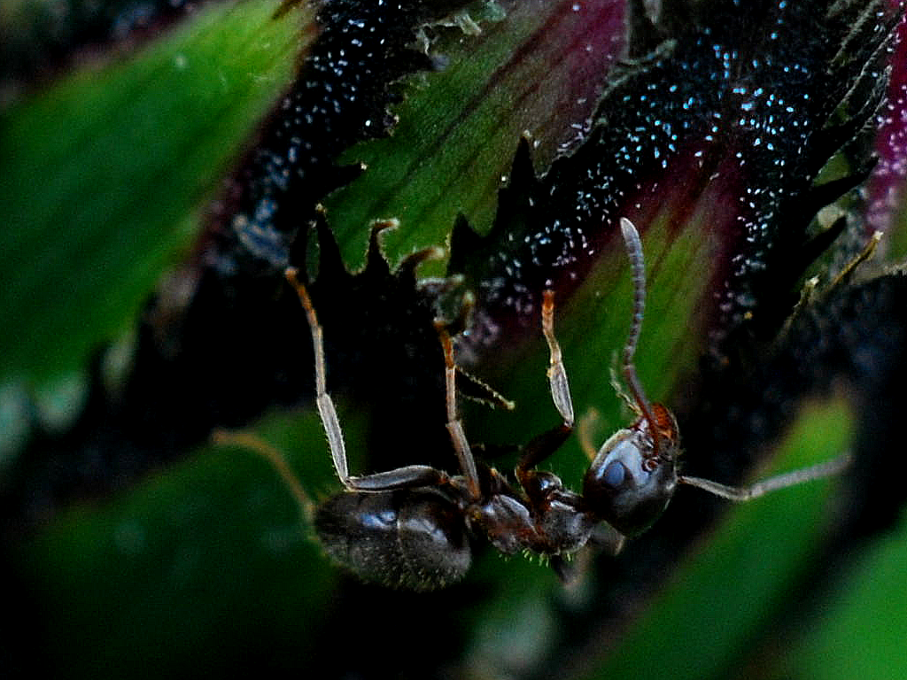

Slide 87
sting
sting
sting
sting
sting
death of fly
sting
sting
sting

Slide 88
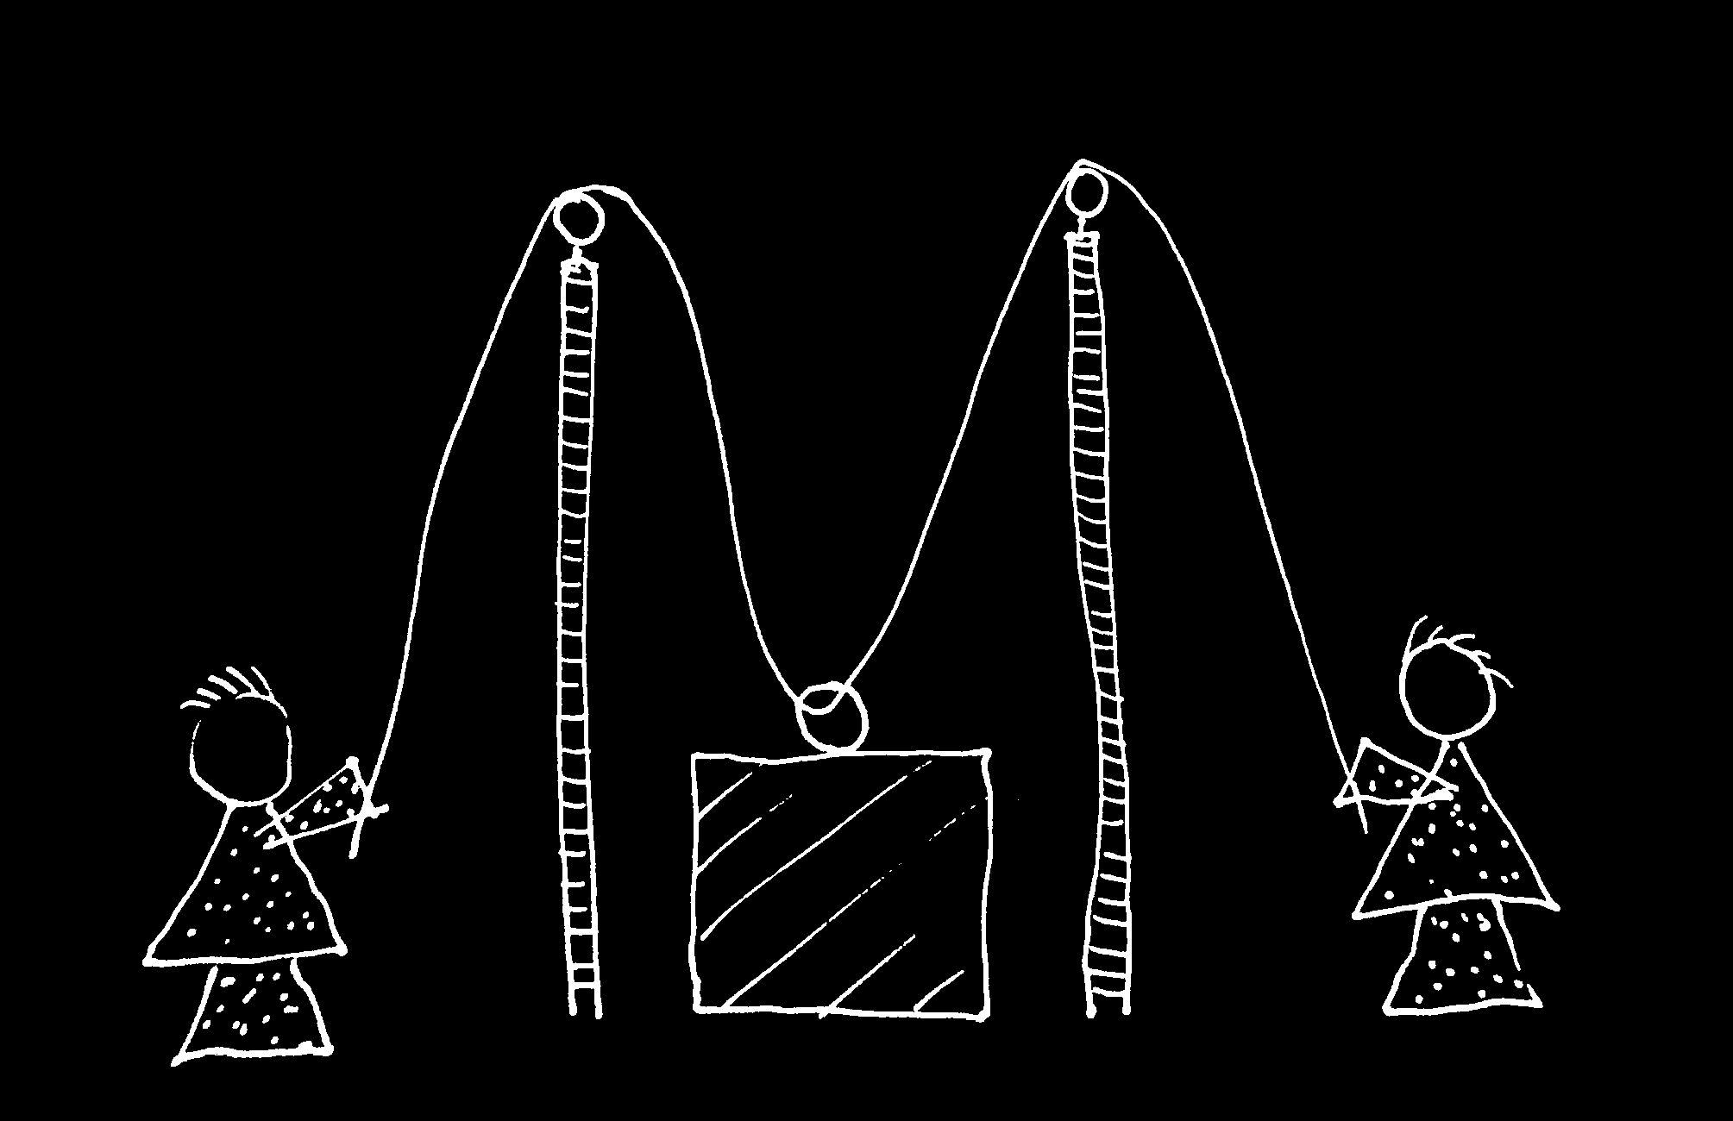

Slide 89
Goal-directed joint action: an event with two or more agents which, taken as a whole, is directed to a goal.
“It ... seems useful to draw a distinction between elementary or thin forms of joint action common to humans and other social mammals and sophisticated or thick forms of joint action, perhaps unique to the human species.”
(Pacherie & Dokic 2006, 110)
G is a distributive goal: it is an outcome to which each agent’s actions are individually directed and it is possible that: all actions succeed relative to this outcome.
G is a collective goal
(a) it is a distributive goal;
(b) the actions are coordinated; and
(c) coordination of this type would normally facilitate occurrences of outcomes of this type.
Notes:
... collective goal doesn’t enable us to draw this distinction ...

Slide 90
Goal-directed joint action: an event with two or more agents which, taken as a whole, is directed to a goal.
G is a distributive goal: it is an outcome to which each agent’s actions are individually directed and it is possible that: all actions succeed relative to this outcome.
G is a collective goal
(a) it is a distributive goal;
(b) the actions are coordinated; and
(c) coordination of this type would normally facilitate occurrences of outcomes of this type.

Slide 91
Goal-directed joint action: an event with two or more agents which, taken as a whole, is directed to a goal.
G is a distributive goal: it is an outcome to which each agent’s actions are individually directed and it is possible that: all actions succeed relative to this outcome.
G is a shared goal
G is a collective goal
(a) it is a distributive goal;
(b) the actions are coordinated; and
(c) coordination of this type would normally facilitate occurrences of outcomes of this type.
Each agent most wants and expects each of the other agents to perform activities directed to the goal.
Each agent most wants and expects the goal to occur as a common effect of all their goal-directed actions.

Slide 92
Goal-directed joint action: an event with two or more agents which, taken as a whole, is directed to a goal.
G is a distributive goal: it is an outcome to which each agent’s actions are individually directed and it is possible that: all actions succeed relative to this outcome.
G is a shared goal
G is a collective goal
(a) it is a distributive goal;
(b) the actions are coordinated; and
(c) coordination of this type would normally facilitate occurrences of outcomes of this type.
Each agent most wants and expects each of the other agents to perform activities directed to the goal.
Each agent most wants and expects the goal to occur as a common effect of all their goal-directed actions.

Slide 93
Goal-directed joint action: an event with two or more agents which, taken as a whole, is directed to a goal.
G is a distributive goal: it is an outcome to which each agent’s actions are individually directed and it is possible that: all actions succeed relative to this outcome.
G is a shared goal
G is a collective goal
(a) it is a distributive goal;
(b) the actions are coordinated; and
(c) coordination of this type would normally facilitate occurrences of outcomes of this type.
Each agent most wants and expects each of the other agents to perform activities directed to the goal.
Each agent most wants and expects the goal to occur as a common effect of all their goal-directed actions.

Slide 94
Goal-directed joint action: an event with two or more agents which, taken as a whole, is directed to a goal.
G is a distributive goal: it is an outcome to which each agent’s actions are individually directed and it is possible that: all actions succeed relative to this outcome.
G is a shared goal
G is a collective goal
(a) it is a distributive goal;
(b) the actions are coordinated; and
(c) coordination of this type would normally facilitate occurrences of outcomes of this type.
Each agent most wants and expects each of the other agents to perform activities directed to the goal.
Each agent most wants and expects the goal to occur as a common effect of all their goal-directed actions.

Slide 95
Goal-directed joint action: an event with two or more agents which, taken as a whole, is directed to a goal.
etc ...
G is a distributive goal: it is an outcome to which each agent’s actions are individually directed and it is possible that: all actions succeed relative to this outcome.
G is a shared goal
G is a collective goal
(a) it is a distributive goal;
(b) the actions are coordinated; and
(c) coordination of this type would normally facilitate occurrences of outcomes of this type.
Each agent most wants and expects each of the other agents to perform activities directed to the goal.
Each agent most wants and expects the goal to occur as a common effect of all their goal-directed actions.

Slide 96
conjecture
The prior existence of capacities for shared agency partially explains how sophisticated forms of mindreading emerge in evolution or development (or both)

Slide 97
1. All shared agency involves shared intention.
2. Shared intention requires sophisticated mindreading.
Therefore:
3. Shared agency could play no significant role in explaining how sophisticated forms of mindreading emerge.
conjecture
The prior existence of capacities for shared agency partially explains how sophisticated forms of mindreading emerge in evolution or development (or both)

Slide 98
challenge
Explain the emergence, in evolution or development, of sophisticated forms of mindreading.
conjecture
The existence of abilities to engage in joint action partially explains how sophisticated forms of mindreading emerge in evolution or development (or both)
2nd objection
Joint action presupposes sophisticated mindreading

Slide 99
tidying up the toys together
(Behne et al 2005)
cooperatively pulling handles in sequence to make a dog-puppet sing
(Brownell et al 2006)
bouncing a ball on a large trampoline together
(Tomasello & Carpenter 2007)
pretending to row a boat together
Notes:
Also some paradigm examples (not sure I want to use these ... maybe stick to the contrast cases).

Slide 100
painting a house together
(Bratman 1992)
lifting a heavy sofa together
(Velleman 1997)
preparing a hollandaise sauce together
(Searle 1990)
going to Chicago together
(Kutz 2000)
walking together
(Gilbert 1990)
tidying up the toys together
(Behne et al 2005)
cooperatively pulling handles in sequence to make a dog-puppet sing
(Brownell et al 2006)
bouncing a ball on a large trampoline together
(Tomasello & Carpenter 2007)
pretending to row a boat together
Notes:
Also some paradigm examples (not sure I want to use these ... maybe stick to the contrast cases).

